Slide 1
ETH Course 402-0248-00L: Electronics for Physicists II (Digital)
1: Setup uC tools, introduction
2: Solder SMD Arduino Nano v3.0 board
3: Build application around ATmega328P
4: Design your own PCB schematic
5: Place and route your PCB
6: Start logic design with FPGAs

Slide 2
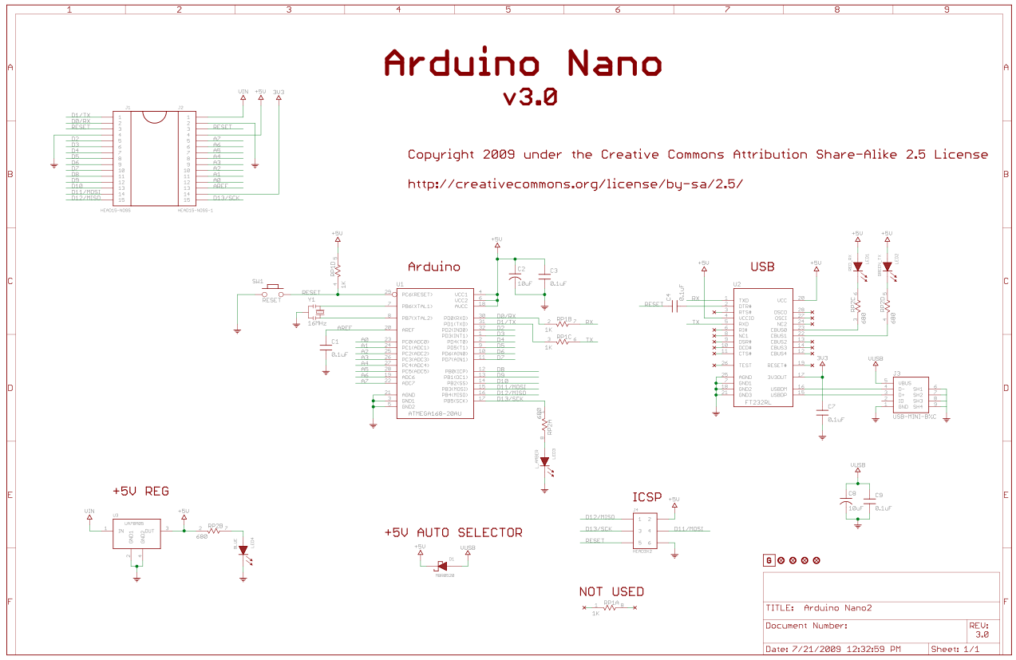

Slide 3
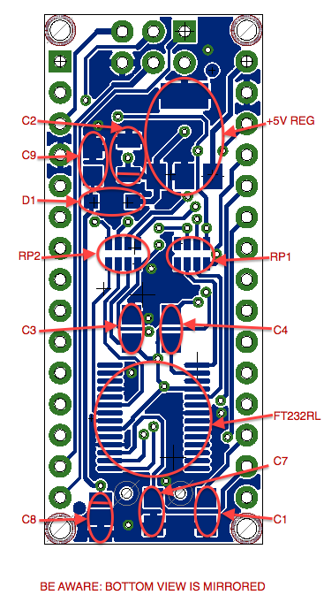
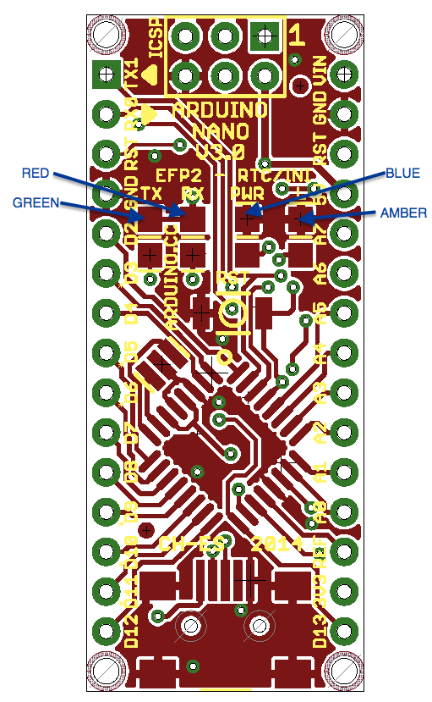
1

Slide 4
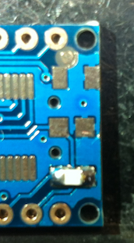
Bottom layer: Capacitors
Start soldering 0.1uF caps C1,C3,C4,C7,C9 and then 10uF Tantalum caps C2,C8
Special cares:
  Fiducial point ring is connected to
  GND plane, and too close to
  Tantalum pad is +5V
  Tantalum pads are too adjusted
  Place the cap well aligned.
  Polarity is very important!!

Slide 5
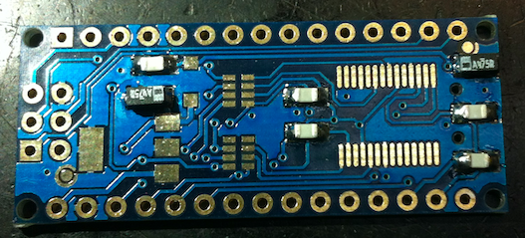
Bottom layer: Capacitors
PCB Eagle view is mirrored from PCB you are soldering
C9
C8
+
+

Slide 6
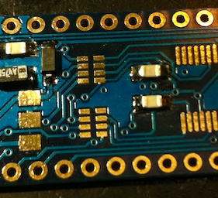
Bottom layer: Schottky diode
D1
Place correctly the diode cathode
cathode

Slide 7
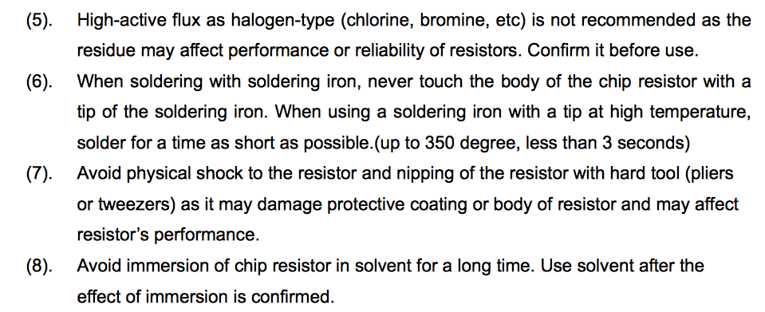
Bottom Layer: Resistor Arrays.
Special cares (taken from panasonic):

Slide 8
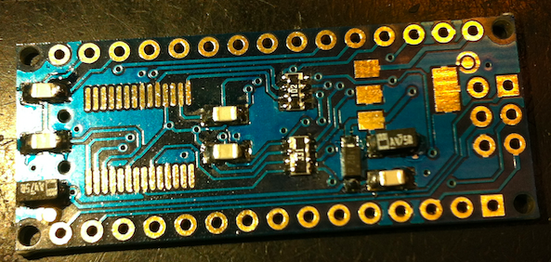
Bottom layer: Resistor Arrays
RP2
RP1

Slide 9
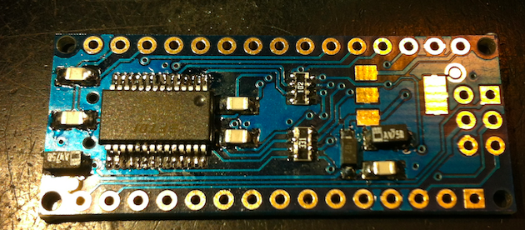
Bottom layer: FT232RL chip
Align correctly before starting to solder. It is recommended to use soldering paste,
but it can be done by using rosin-core solder wire.
If pins get soldered together remove excess solder with the solder wick

Slide 10
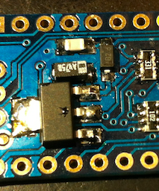
Bottom layer: +5v REG
This component need more temperature. Be patient.

Slide 11
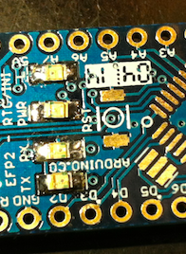
Top layer: LEDs
LED’s cathode is represented with a green line.
L and PWR LEDs have the cathode on the left of this figure, and TX/RX on the right.
Select the colors carefully: L is amber, PWR blue, RX red and TX green

Slide 12
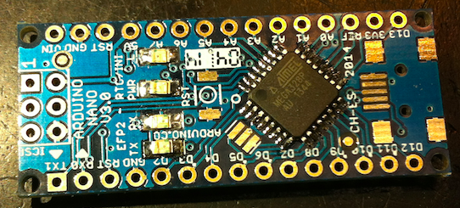
Top layer: Atmega328P
Place correctly the microcontroller. Its mark correspond to pin1 and this is also marked on the PCB.

Slide 13
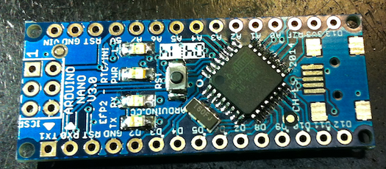
Top layer: Resonator and Reset button
Resonator has no polarity. Central pad is GND. It doesn’t matter the orientation.
Reset button has only two pads. It hasn’t had polarity neither.

Slide 14
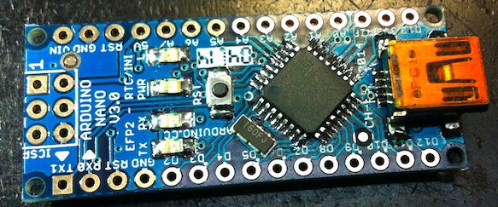
Top layer: USB connector
The only tricky thing with this connector is that you must push the connector in order to ensure that the pins touch the pads. There are two small holes where the connector must fit and it needs some extra force to fit them.

Slide 15
Pin Arrays
Your last step before programming it is to solder the 2 rows of 15 pins and the ISCP connector.

Slide 16
Does it works?
If yes, you can go to the instructions to make your Arduino board compatible with Sketches.
If not (most probably):
  Inspect and review with the microscope all the solders.
  Be careful with resistor arrays, they are too delicate. Not exceed 3s of ironing!!
  C8 Tantalum cap can give you too much headache if not soldered properly.

